Slide 1


Project
HOSPITAL DATABASE
EDUCATIONAL PRACTICE
Student: Yasmina Abenova
Group: SE-2016
Teacher: Aidana Kalakova

Slide 2
STAGE 1.
The Project and its Purpose

Slide 3

IDENTIFY PROJECT TOPIC

Slide 4

THE PURPOSE
The purpose of this project is to make DBMS for a hospital with all the information about medical staff and patients.

Slide 5
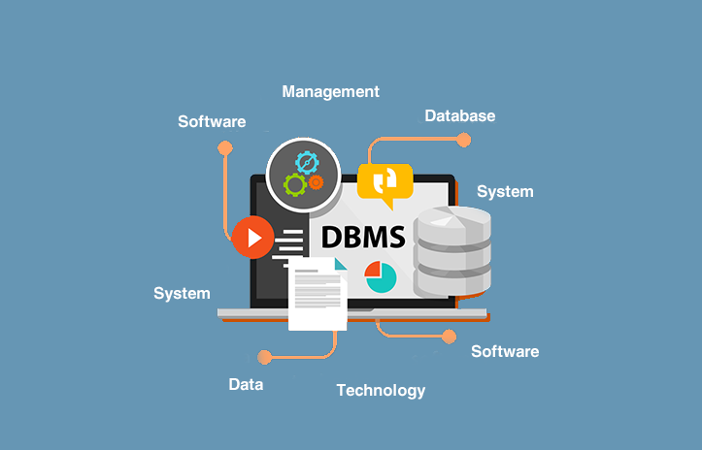
WHAT IS A DBMS?
A Database Management System (DBMS) is software designed to store, retrieve, define, and manage data in a database.

Slide 6

METHODOLOGY
In order to create hospital’s database and achieve successful result for the project, It was decided to use Structured Query Language (SQL). More precisely, I will develop my project in PostgreSQL (pgAdmin4)

Slide 7
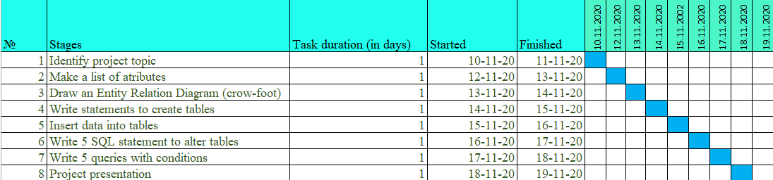
THE STAGES AND PROGRESS. The Gannt Chart.

Slide 8
STAGE 1.
Tables and ERD.

Slide 9
TABLES.
Hospital
Departments
Doctors
Treatment
Bill
Rooms
Patients
Appointments

Slide 10
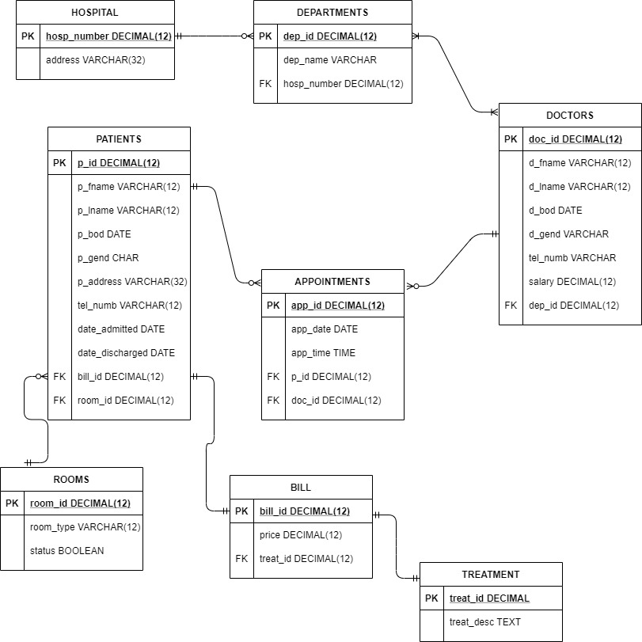
ENTITY RELATION DIAGRAM

Slide 11
STAGE 3.
Creating Tables.

Slide 12

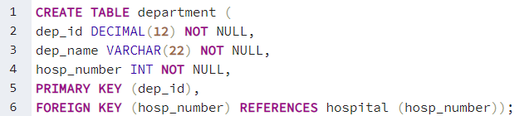
CREATING TABLES. Hospital and Departments.

Slide 13
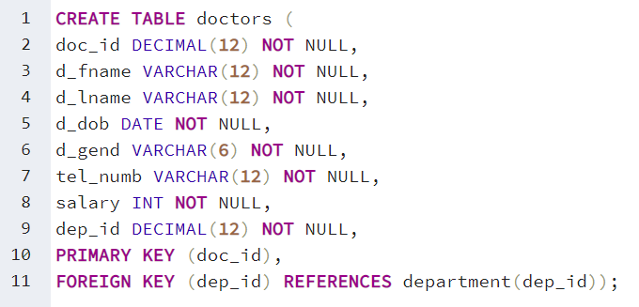
CREATING TABLES. Doctors.

Slide 14
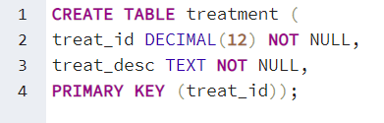
CREATING TABLES. Treatment.

Slide 15
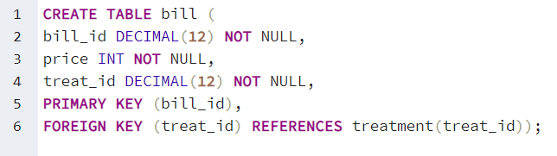
CREATING TABLES. Bill.

Slide 16
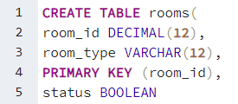
CREATING TABLES. Rooms.

Slide 17
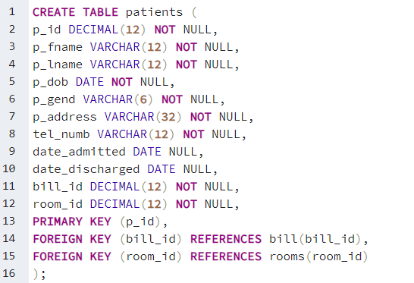
CREATING TABLES. Patients.

Slide 18
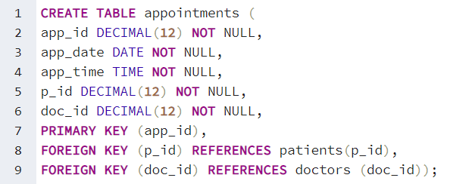
CREATING TABLES. Appointments.

Slide 19
STAGE 4.
Inserting Data.

Slide 20

INSERTING DATA. Hospital.

Slide 21
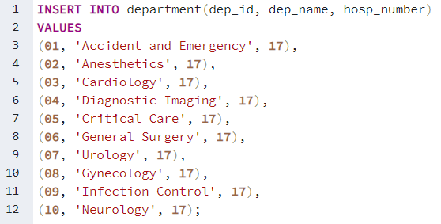
INSERTING DATA. Departments.

Slide 22
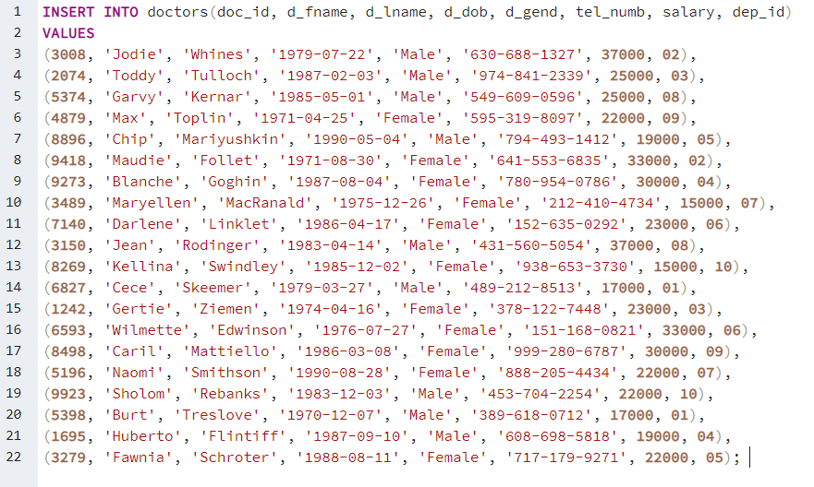
INSERTING DATA. Doctors.

Slide 23
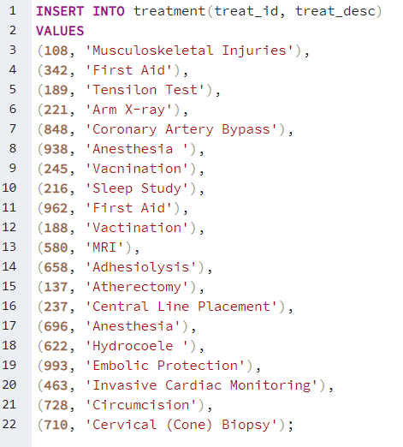
INSERTING DATA. Treatment.

Slide 24
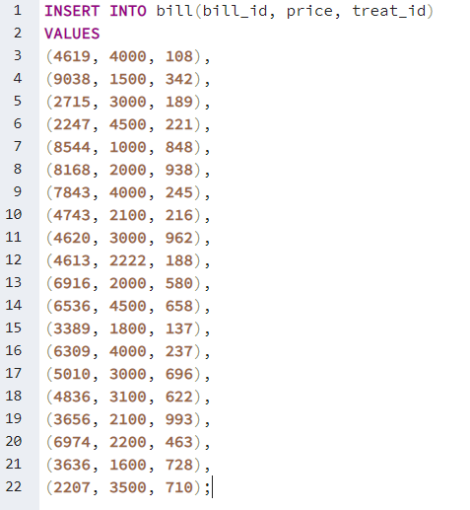
INSERTING DATA. Bill.

Slide 25
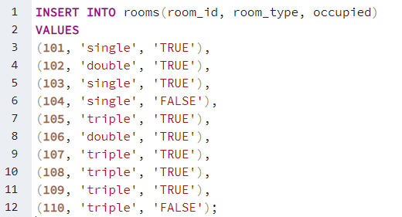
INSERTING DATA. Rooms.

Slide 26
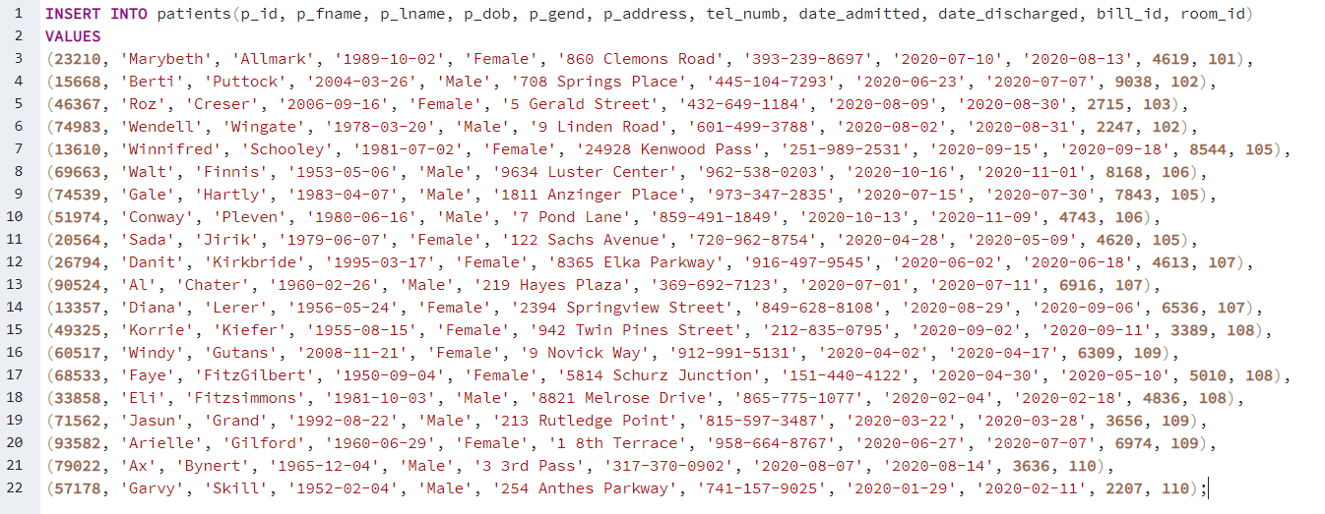
INSERTING DATA. Patients.

Slide 27
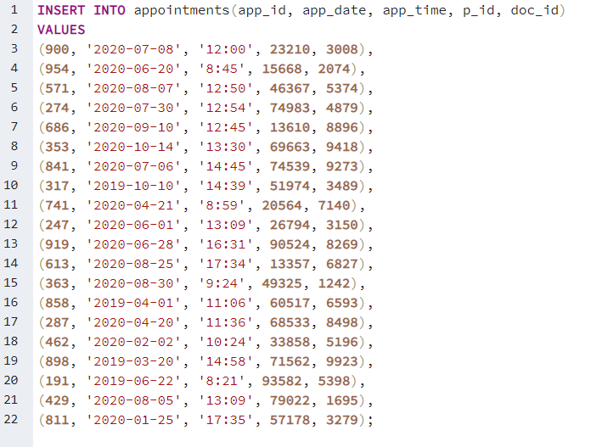
INSERTING DATA. Appointments.

Slide 28
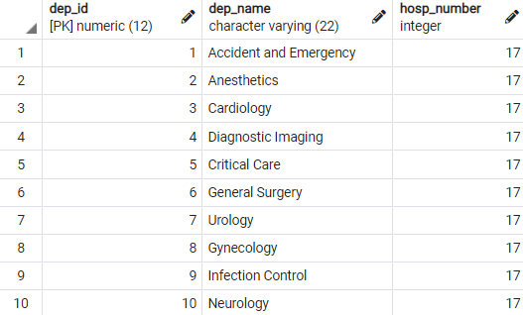

TABLES. Hospital & Departments.

Slide 29
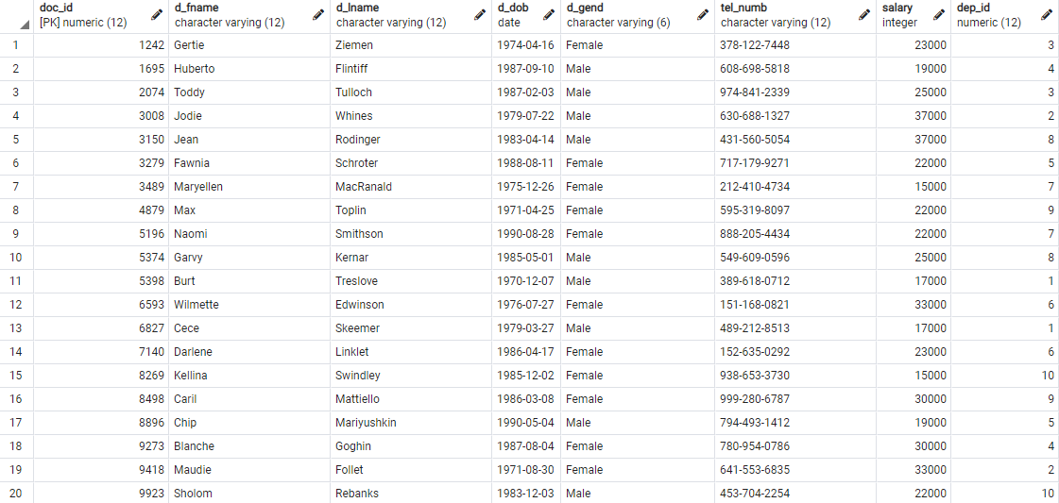
TABLES. Doctors.

Slide 30
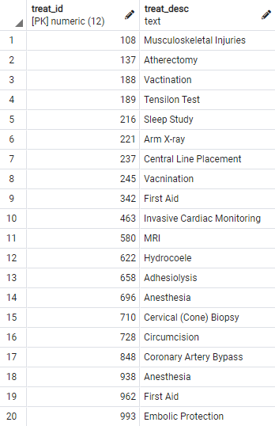
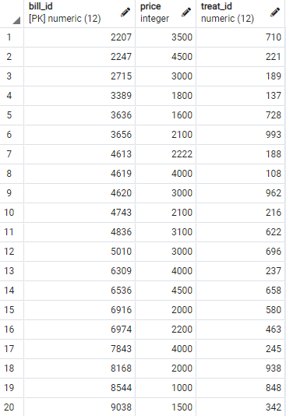
TABLES. Treatment & Bill.

Slide 31
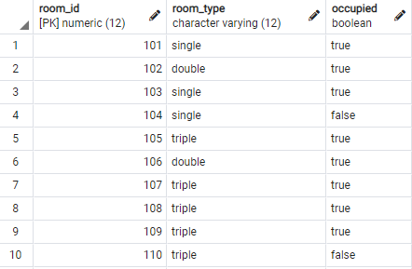
TABLES. Rooms.

Slide 32
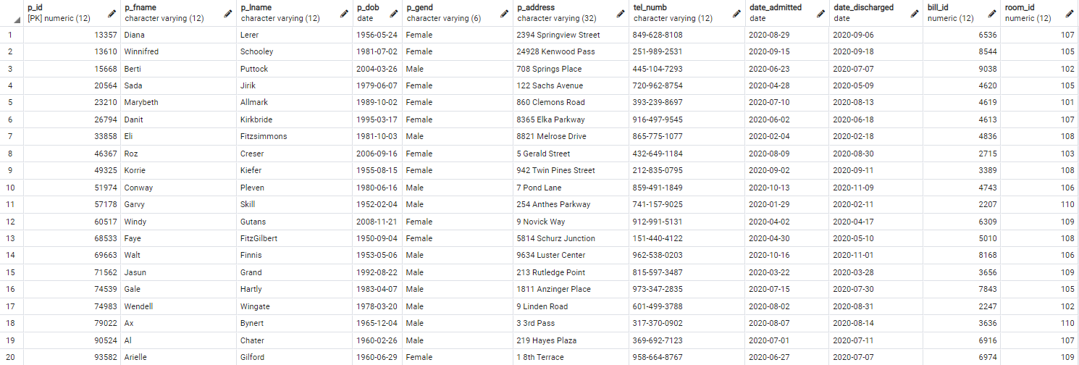
TABLES. Patients.

Slide 33
STAGE 5.
‘Alter’ Statements

Slide 34
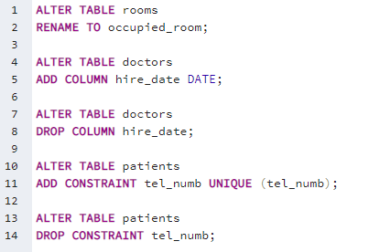
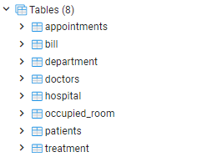
‘ALTER’.

Slide 35
STAGE 6.
Condition Statements

Slide 36
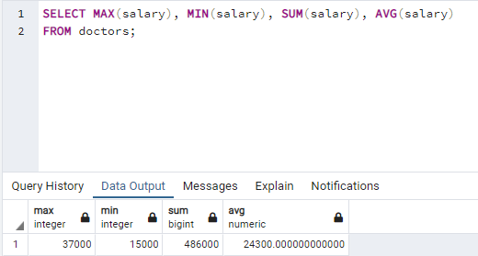
Condition Statements.

Slide 37
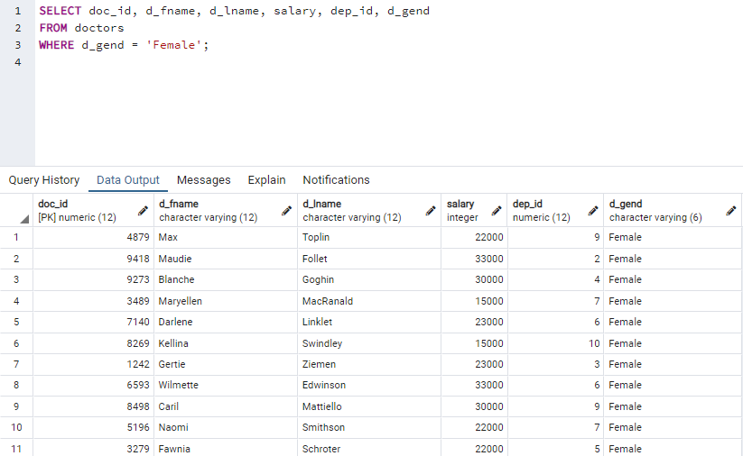
Condition Statements.

Slide 38
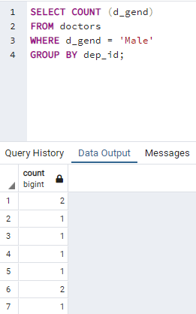
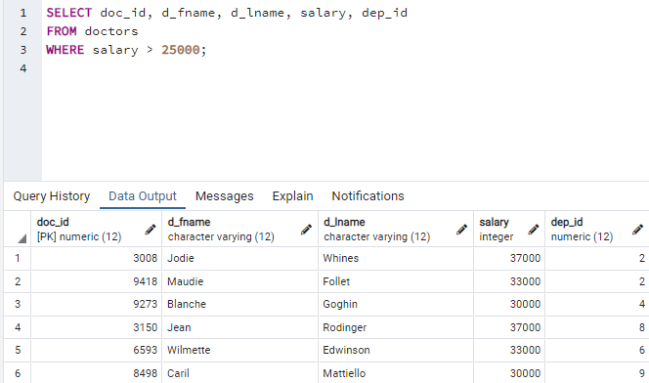
Condition Statements.

Slide 39
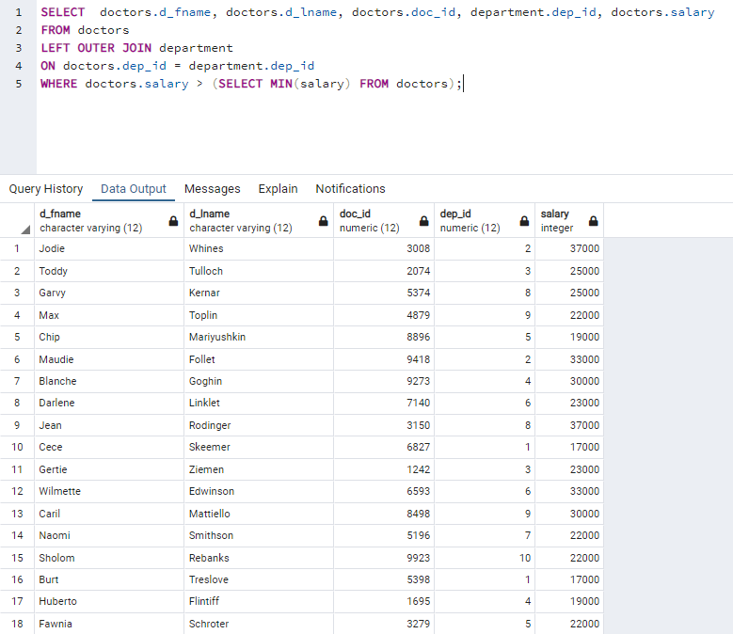
Condition Statements.

Slide 40
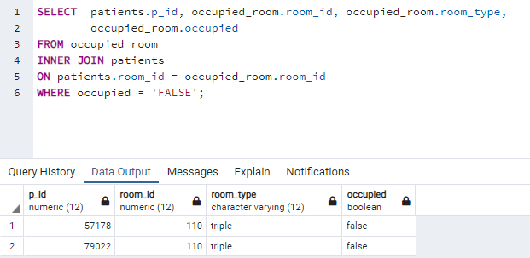
Condition Statements.

Slide 41
.
THANK YOU
FOR YOUR ATTENTION!

